Slide 1

Machine Learning #5
Module Leader: Dr Grace U. Nneji

Slide 2
01
Rules
02
Learning outcomes
CONTENTS
03
References
04
Artificial Neural Network
05
Seminar Session 1
06
Training Steps
07
Activation function
08
Multiclass Classification

Slide 3

01
Rules
Be on time
Bring your stuff (Pen, papers, folder, brain)
No pressing of phone, or gaming in the class.
Habit of Effective learners.
Prepare for your coursework and exam on time.
Always revise your PPTs before and after class.
Have Fun

Slide 4
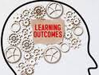
02
Learning Outcomes
Students will be able to:
Get familiar with the diagram and components of a neural network
Understand the concept of a "layer" in a neural network
Understand how neural networks learn new features.
Understand how activations are calculated at each layer.
Learn how a neural network can perform classification on an image.
Use a framework, TensorFlow, to build a neural network for classification of an image.
Learn how data goes into and out of a neural network layer in TensorFlow
Build a neural network in regular Python code (from scratch) to make predictions.

Slide 5

03
References
1. Bishop, C. M. (2006). Pattern Recognition and Machine Learning. Springer.
2. Géron, A. (2019). Hands-On Machine Learning with Scikit-Learn, Keras, and TensorFlow. O'Reilly Media.
3. Murphy, K. P. (2012). Machine Learning: A Probabilistic Perspective. MIT Press.
4. Goodfellow, I., Bengio, Y., & Courville, A. (2016). Deep Learning. MIT Press.
5. Hastie, T., Tibshirani, R., & Friedman, J. (2009). The Elements of Statistical Learning: Data Mining, Inference, and Prediction. Springer.

Slide 6
04
Artificial Neuron Network

Slide 7
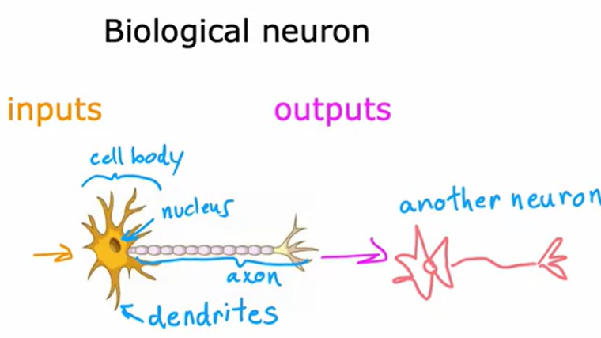
04
Biological Neuron
A neuron comprises a cell body with different inputs and a nucleus can be recognize in the neuron.
In a biological neuron, the input wires are called the dendrites, and it then occasionally sends electrical impulses to other neurons via the output wire, which is called the axon.

Slide 8
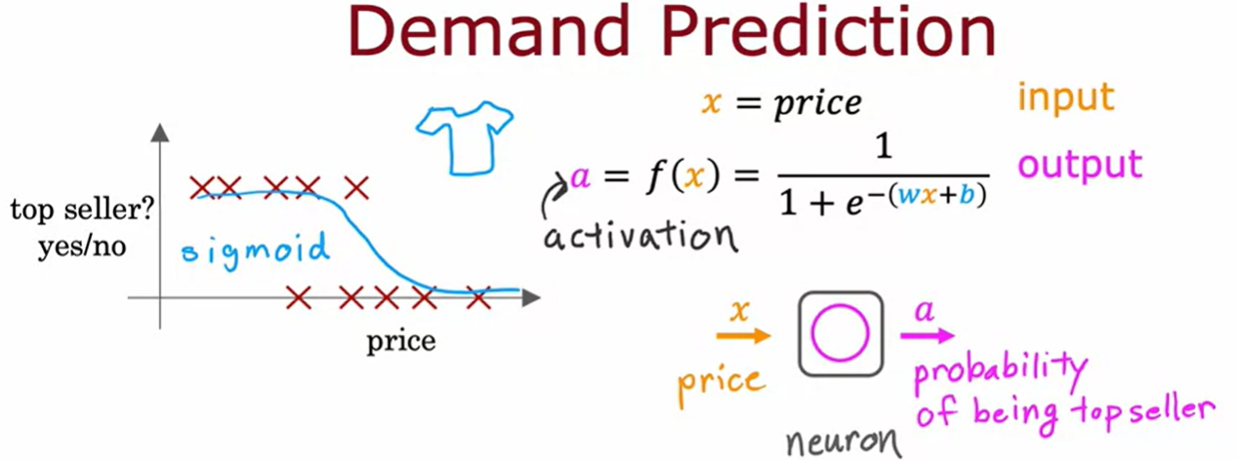
04
Biological Neuron
In this example, consider if you're selling T-shirts and you would like to know if a particular T-shirt will be a top seller, yes or no, and you have collected data of different t-shirts that were sold at different prices, as well as which ones became a top seller.
The term a stands for activation which refers to how much a neuron is sending a high output to other neurons downstream from it.

Slide 9
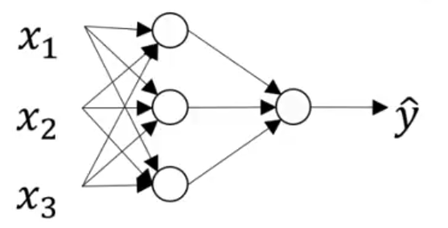
Neural Network Representation
04
Notation Convention
Input Layer: this contains the input value ‘x’ to the neural network.
Hidden Layer: the true value of this node is not observable.
Output Layer: responsible for generating the predicted value ‘y’
Input
layer
Hidden
layer
Output
Layer
2 layer Neural Network

Slide 10
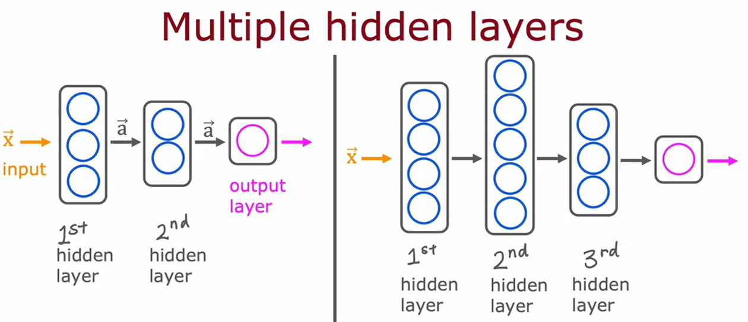
Neural Network Architecture
04

Slide 11
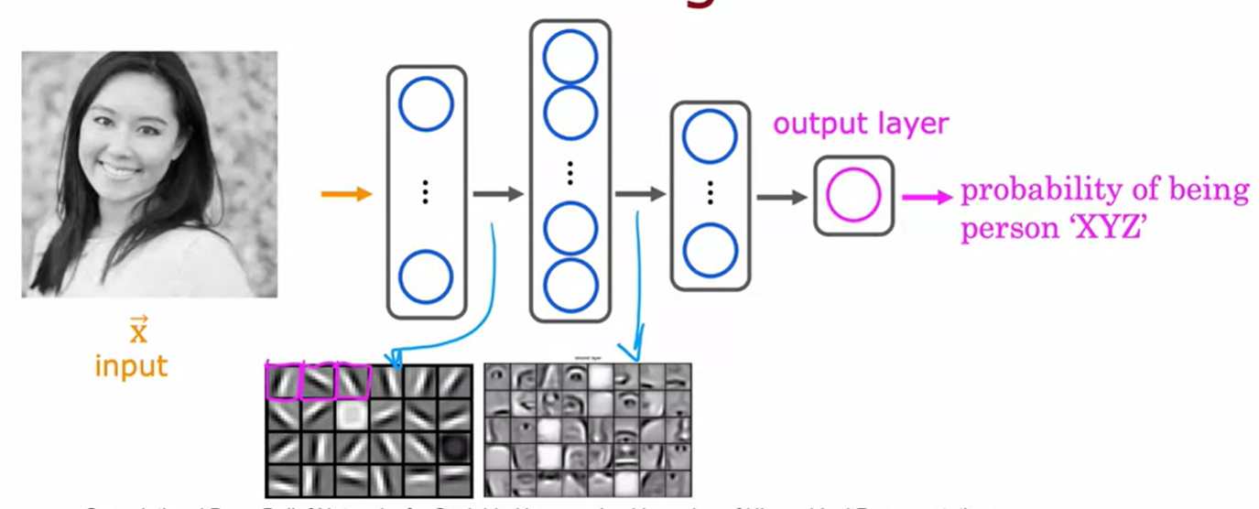
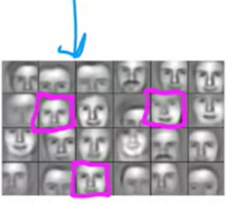
Neural Network Architecture
04
This image is 1,000 by 1,000 pixels forming 1,000 by 1,000 grid (matrix of pixel intensity values)
1st Hidden layer:
1st neuron looks for the low vertical line or edge.
2nd neuron looks for oriented line or edge.
3rd neuron looks for a line at that orientation, etc.
Next Hidden layer:
1st neuron tries to detect the presence or absence of an eye in a certain position of the image.
3rd neuron tries to detect like a corner of a nose.
Next hidden layer:
NN is aggregating different parts of faces to then try to detect presence or absence of larger, coarser face shapes.
Finally, to detect how much the face aligns to different face shapes creates a rich set of features that then helps the output layer try to determine the identity of the person picture.

Slide 12
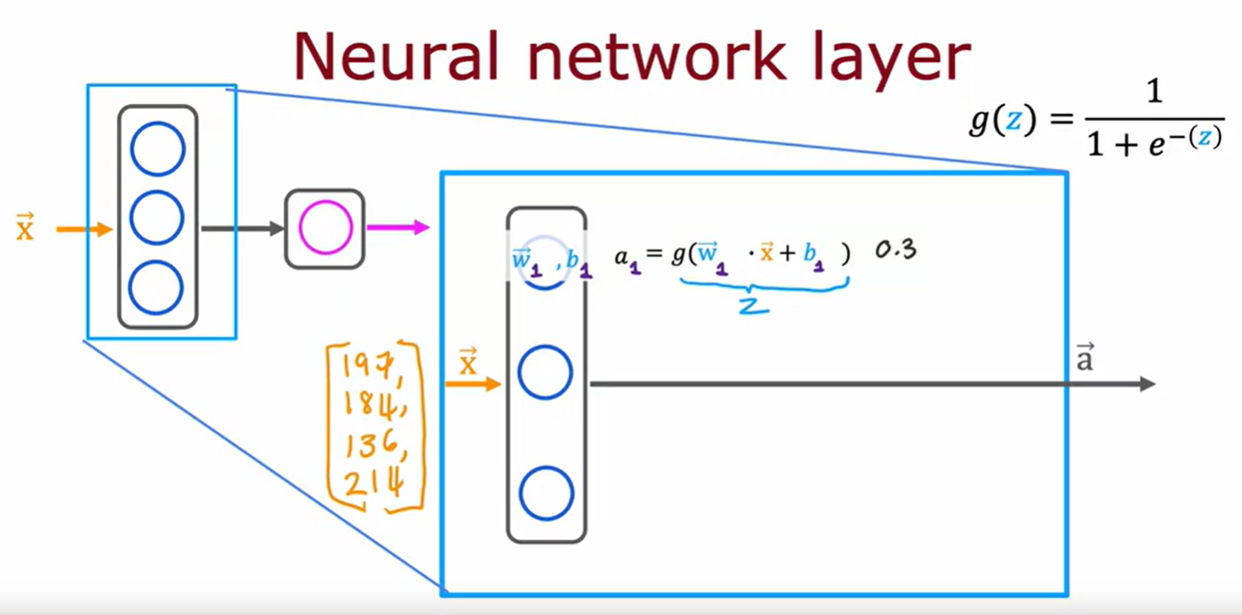
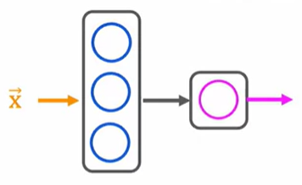
Neural Network Layer
04
The fundamental building block of most modern neural networks is a layer of neurons. Let's take a look at how a layer of neurons works.
Consider Layer 1

Slide 13
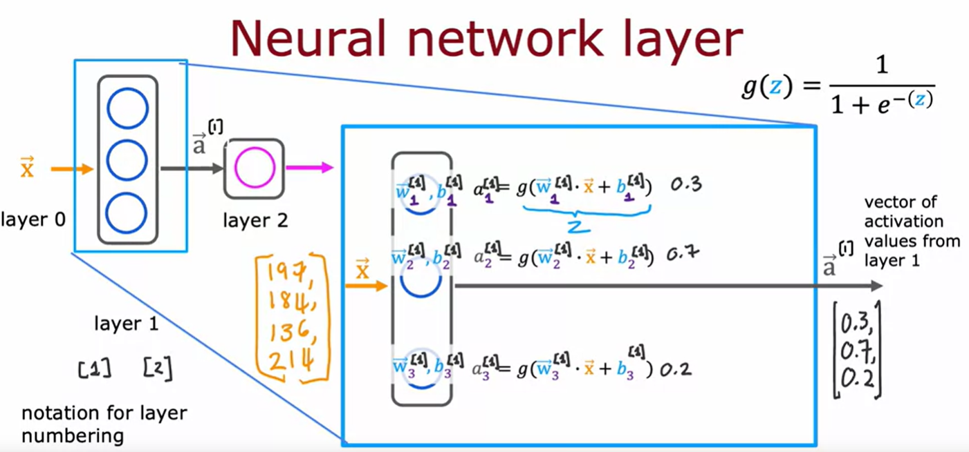
Neural Network Layer
04

Slide 14
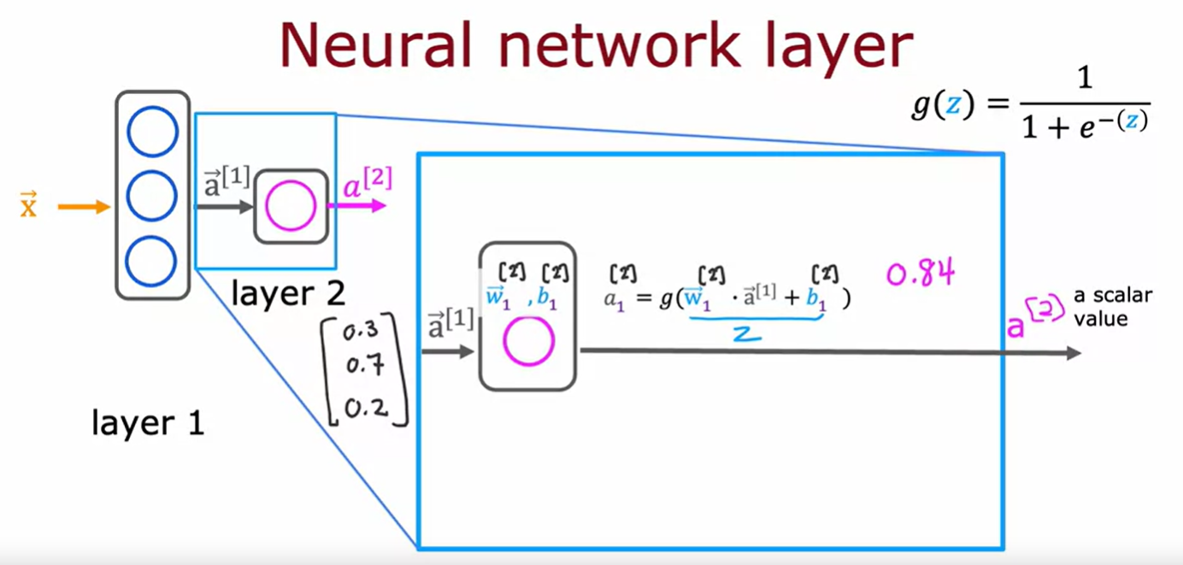
Neural Network Layer
04
Consider Layer 2

Slide 15
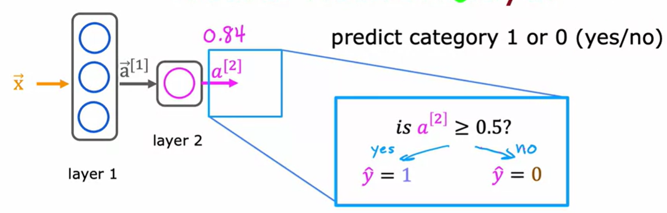
Neural Network Layer
04
Consider the output layer

Slide 16
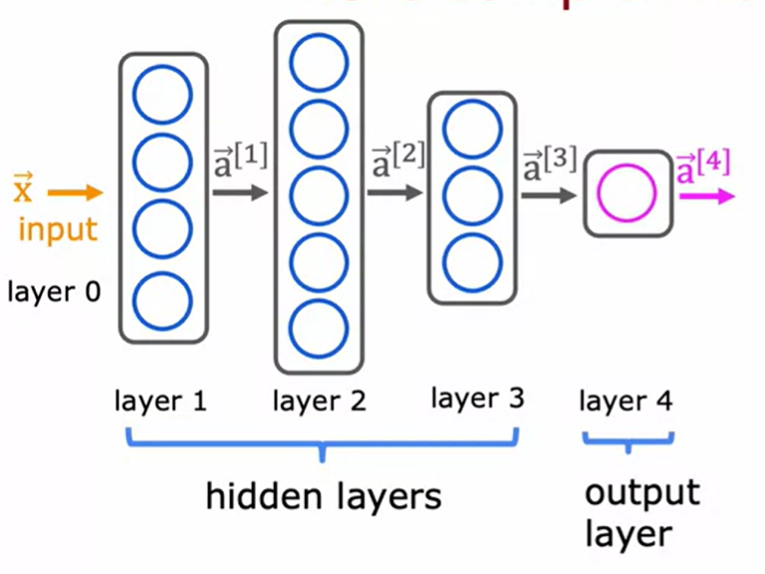
More Complex Neural Network
04
Consider a complex neural network

Slide 17
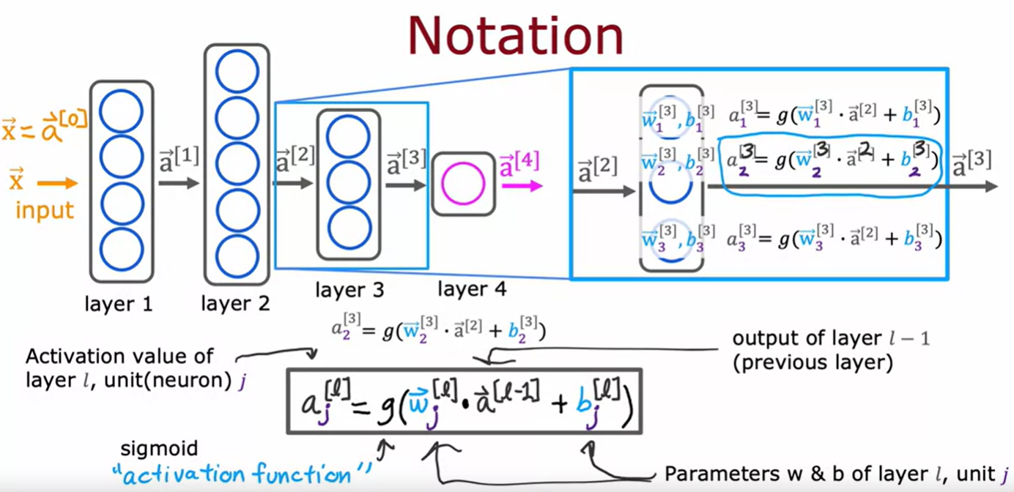
More Complex Neural Network
04
Consider a complex neural network

Slide 18
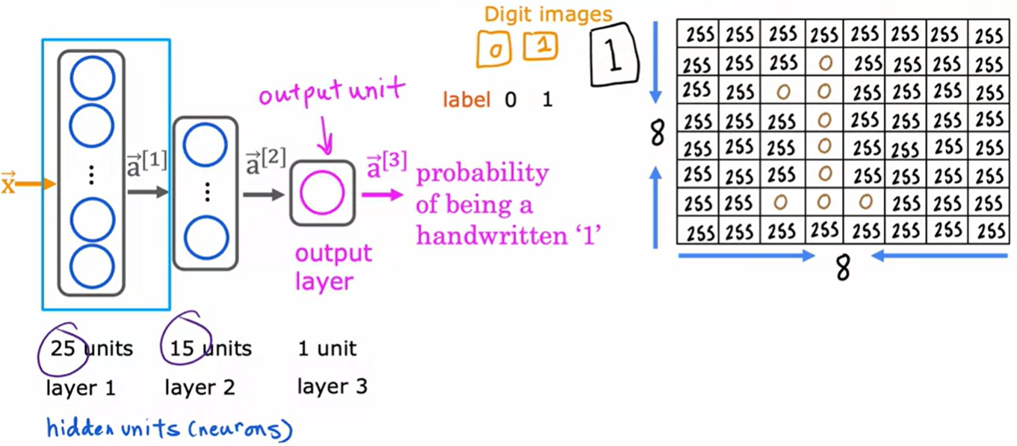
Handwritten Digit Recognition
04

Slide 19
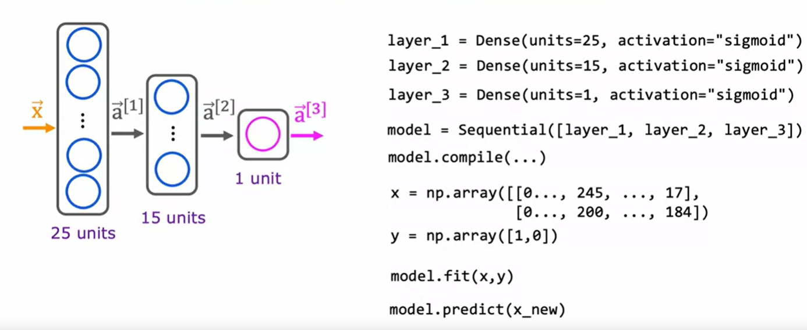
Handwritten Digit Recognition Model
04
Rather than just to just call five lines of code and not really also know what the code is actually doing underneath the hood. There is need to implement from scratch for easy debug and understanding

Slide 20
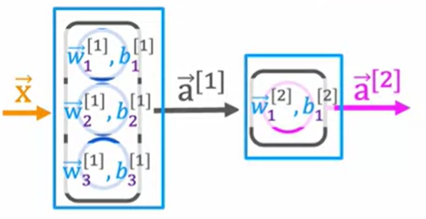
Forward Propagation
04
Consider a forward propagation using a coffee roasting

Slide 21
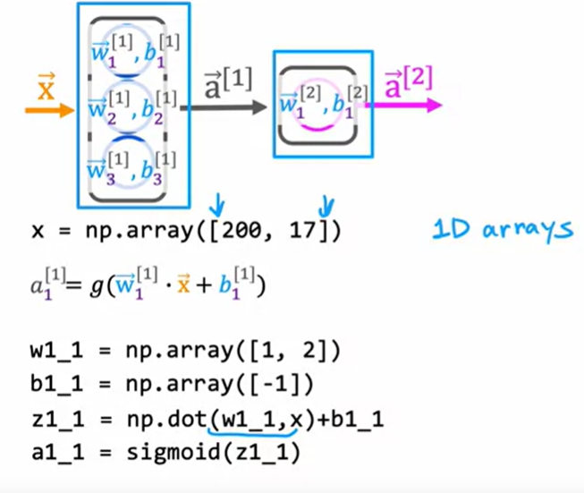
Forward Propagation in a single layer
04
Consider a forward propagation using a coffee roasting model

Slide 22
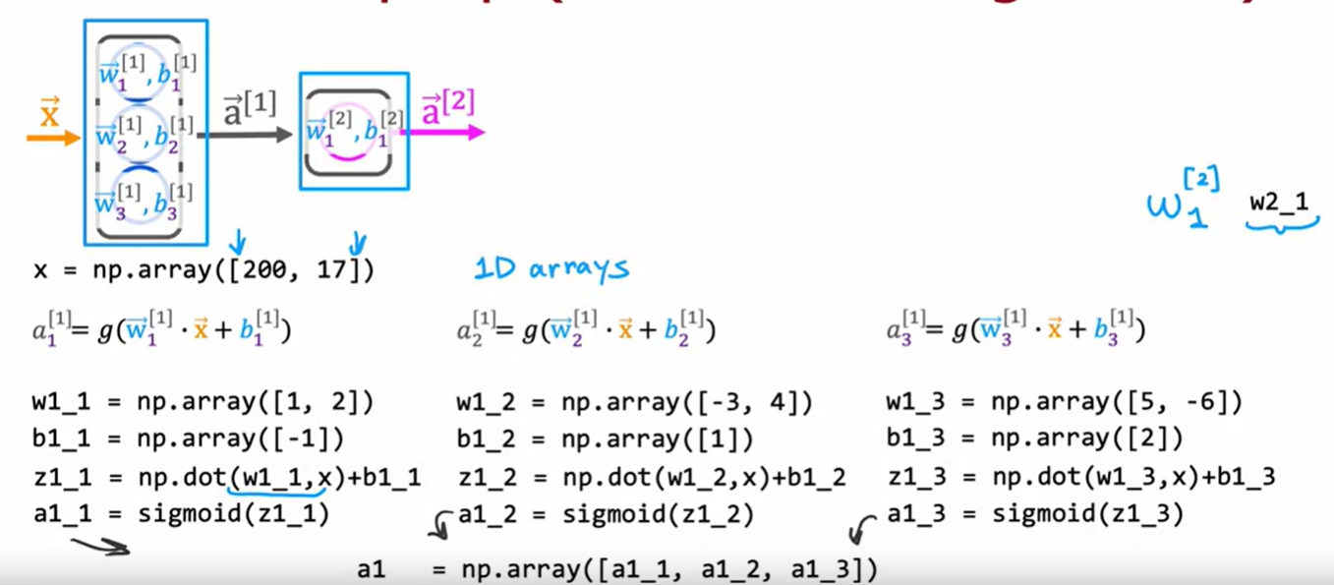
Forward Propagation in a single layer
04

Slide 23
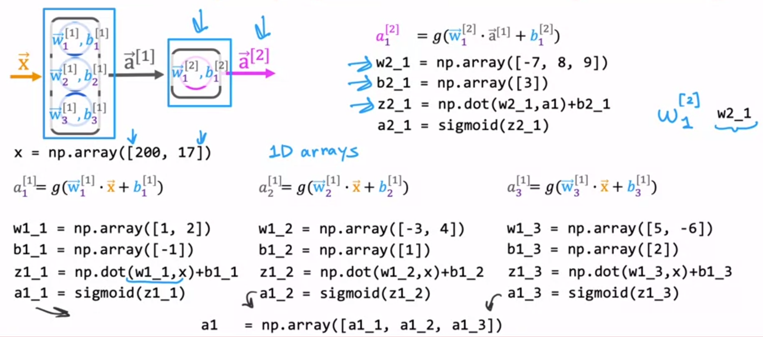
Forward Propagation in a single layer
04

Slide 24
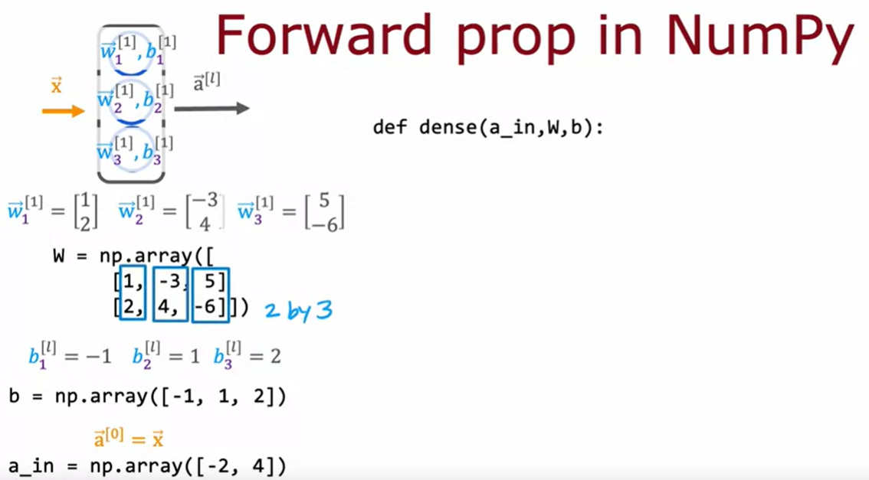
Forward Propagation in Numpy
04

Slide 25
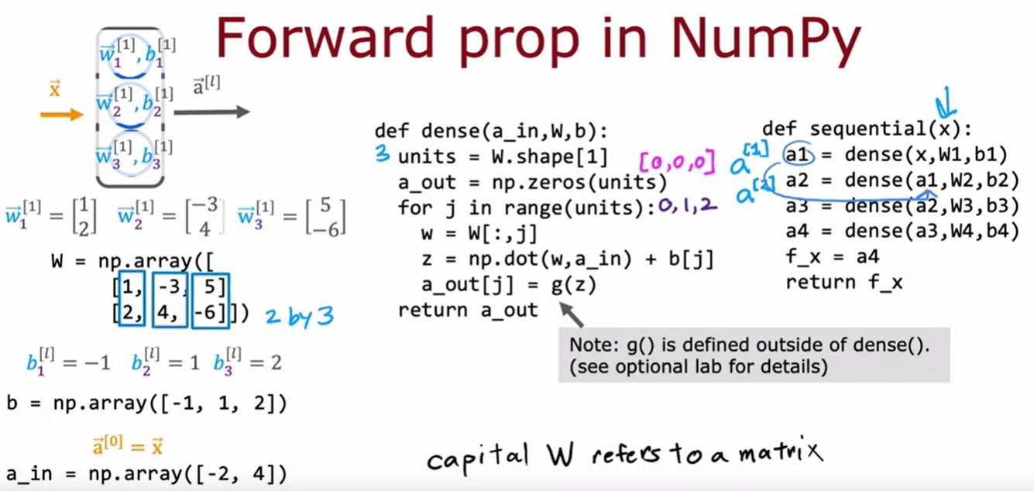
Forward Propagation in a single layer
04

Slide 26
05
Seminar Session 1

Slide 27
05
Seminar Session (Instructions)
Let’s understand how artificial neural network works
You’ll explore the implementation of ANN in Tensorflow model.
You’ll also explore the implementation of ANN in Numpy model.
Open the ‘W5 - ANN in Both Tensorflow & Numpy Model Implementation.ipynb’ file.

Slide 28
05
Seminar Session 1
Open the jupyter notebook file titled
‘W5 - ANN in Both Tensorflow & Numpy Model Implementation.ipynb’
on your browser.

Slide 29
06
Training Steps

Slide 30
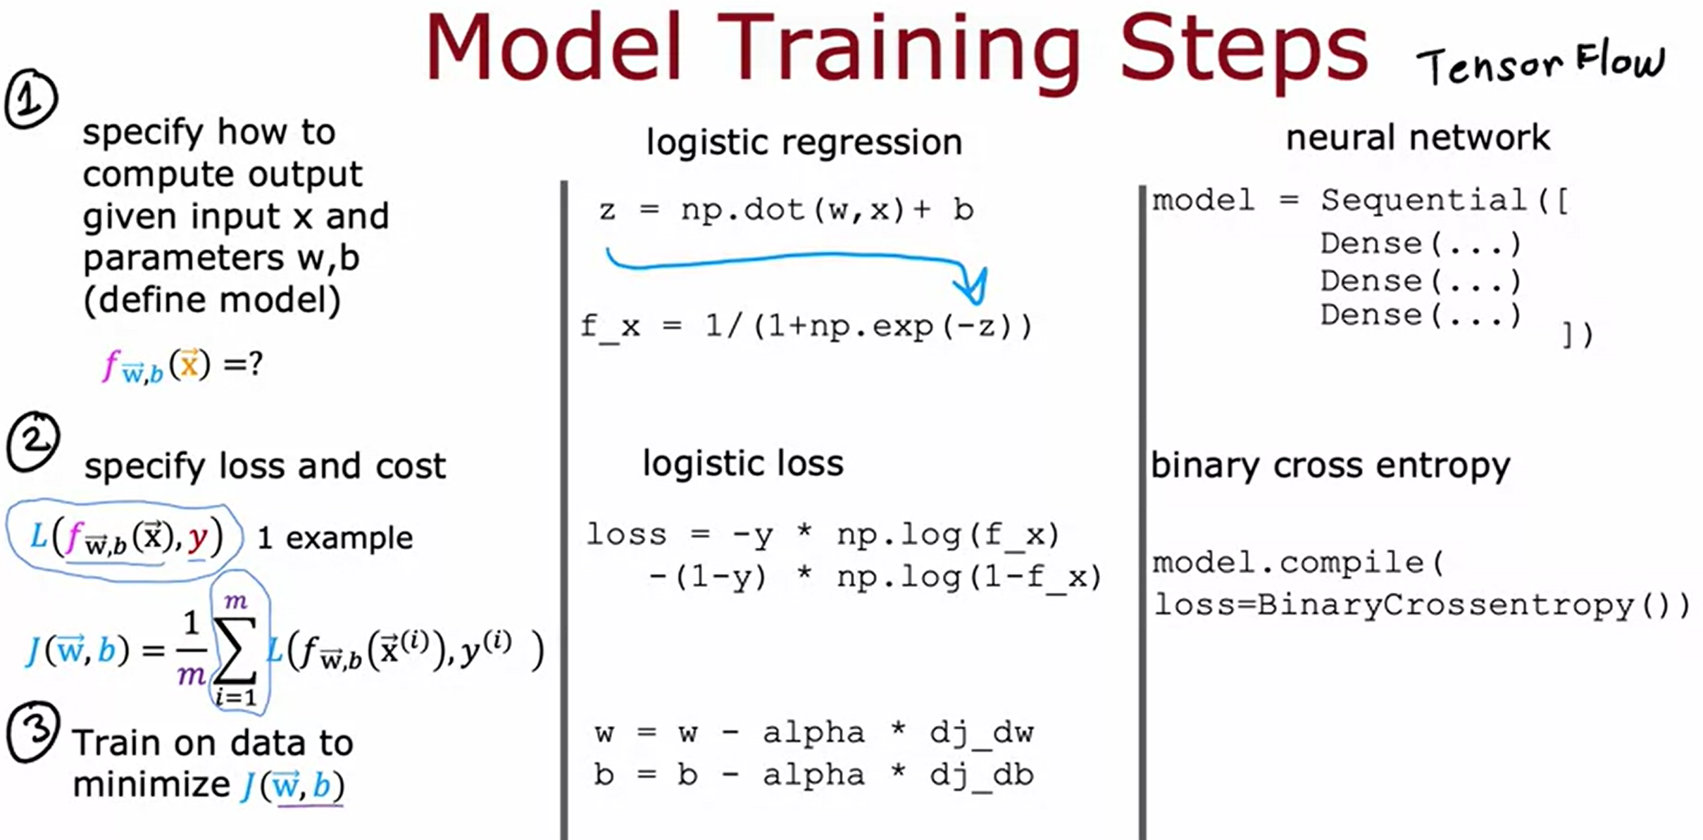
Model Training Steps
06

Slide 31
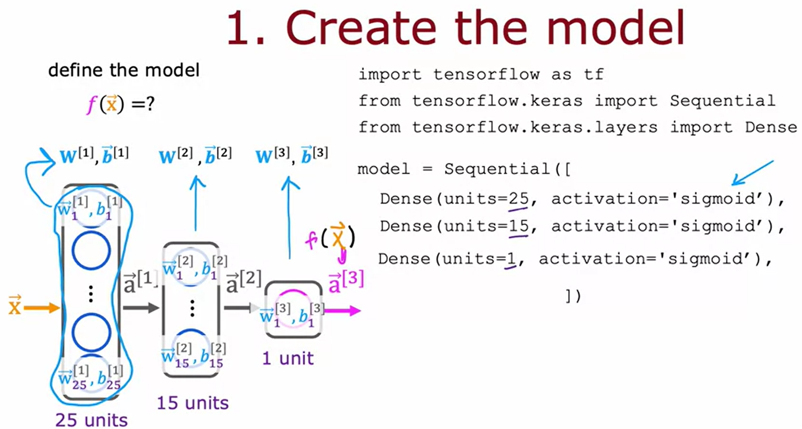
Model Training Steps
06

Slide 32
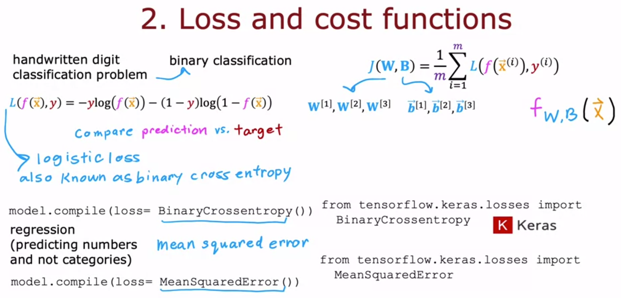
Model Training Steps
06

Slide 33
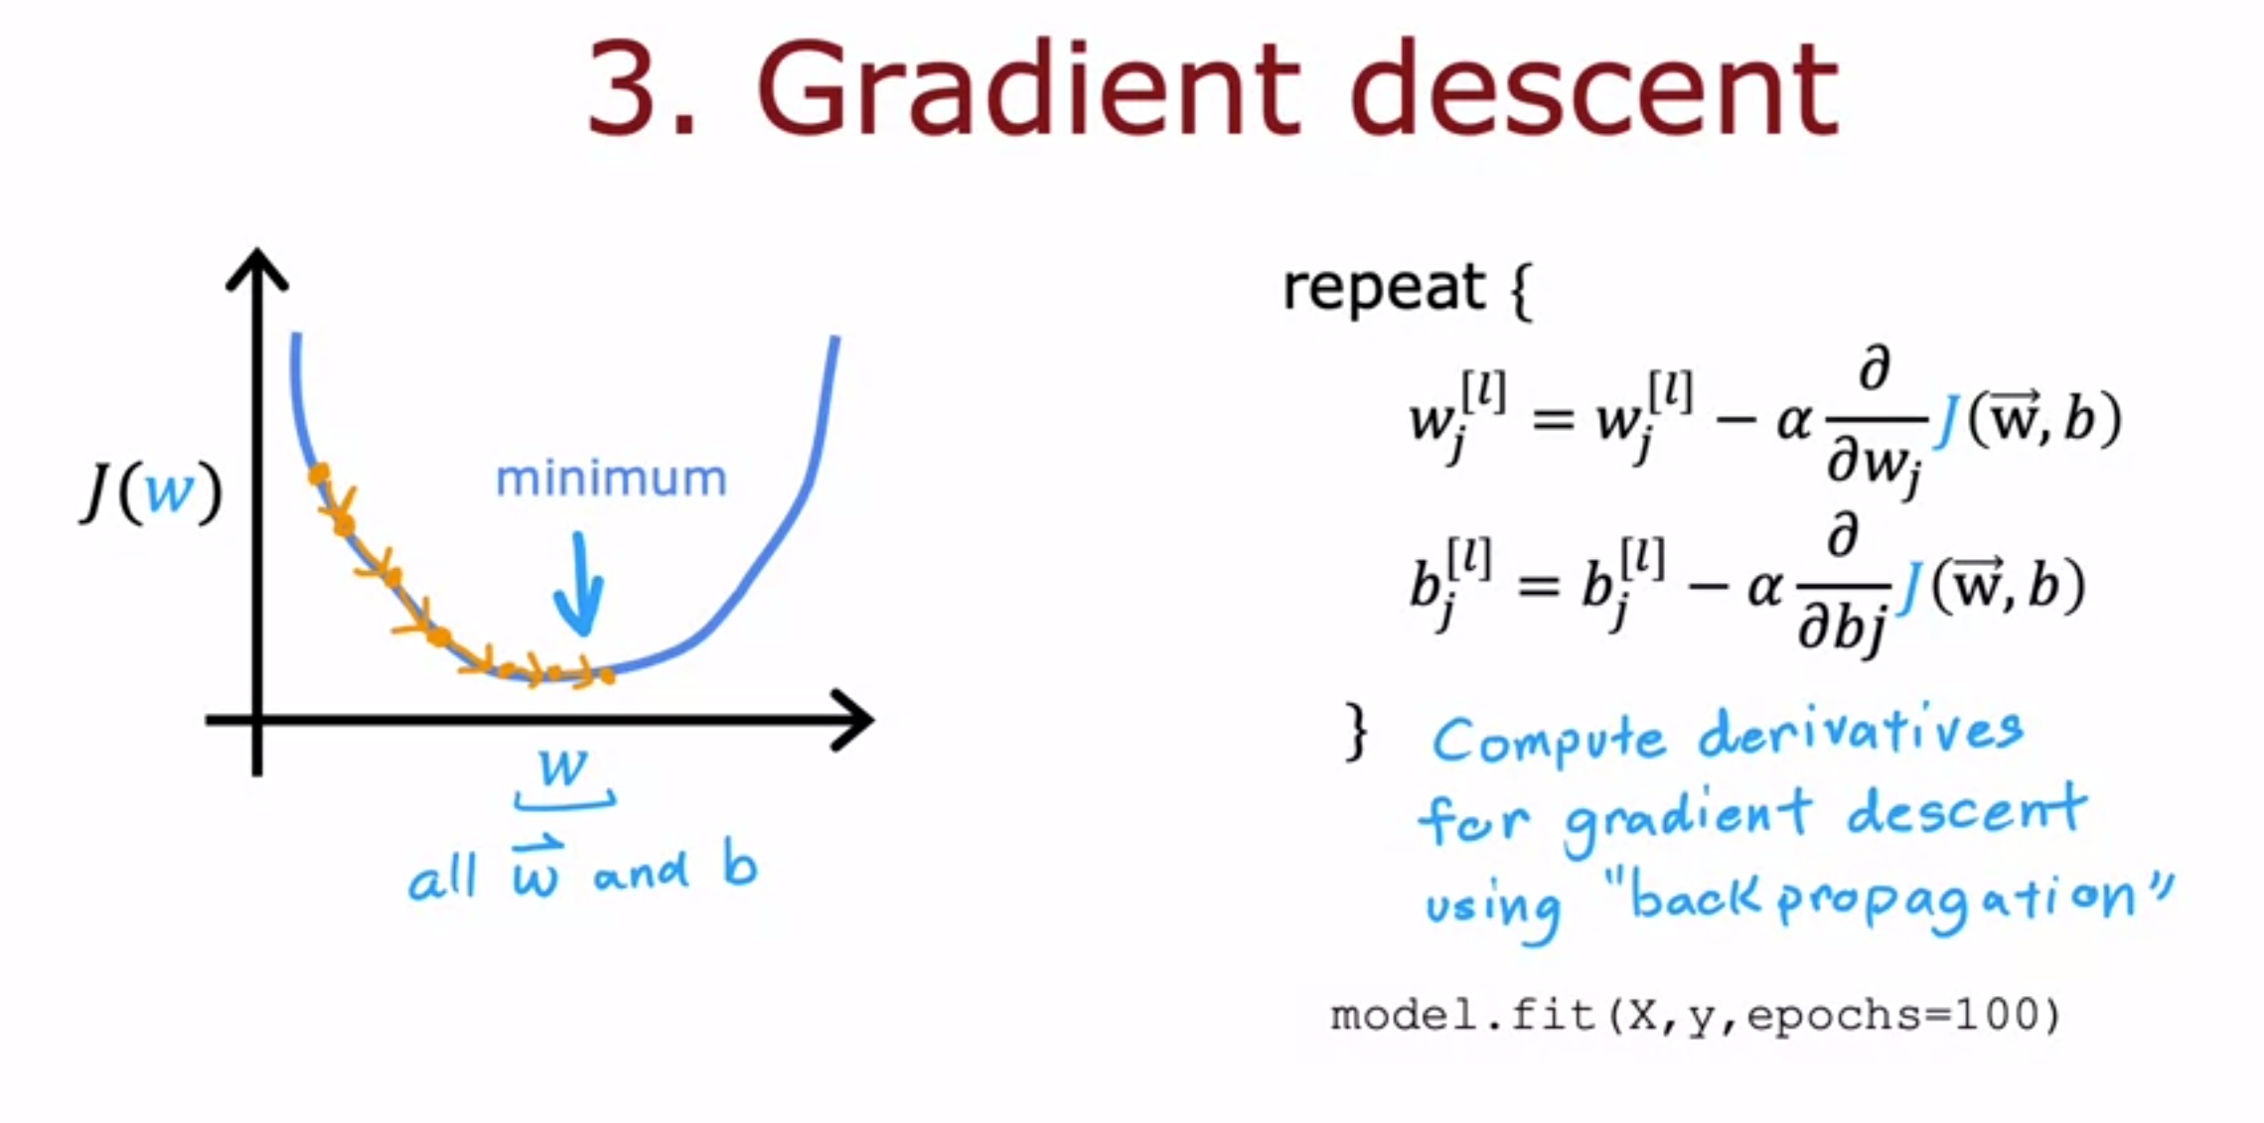
Model Training Steps
06

Slide 34
07
Activation Function

Slide 35
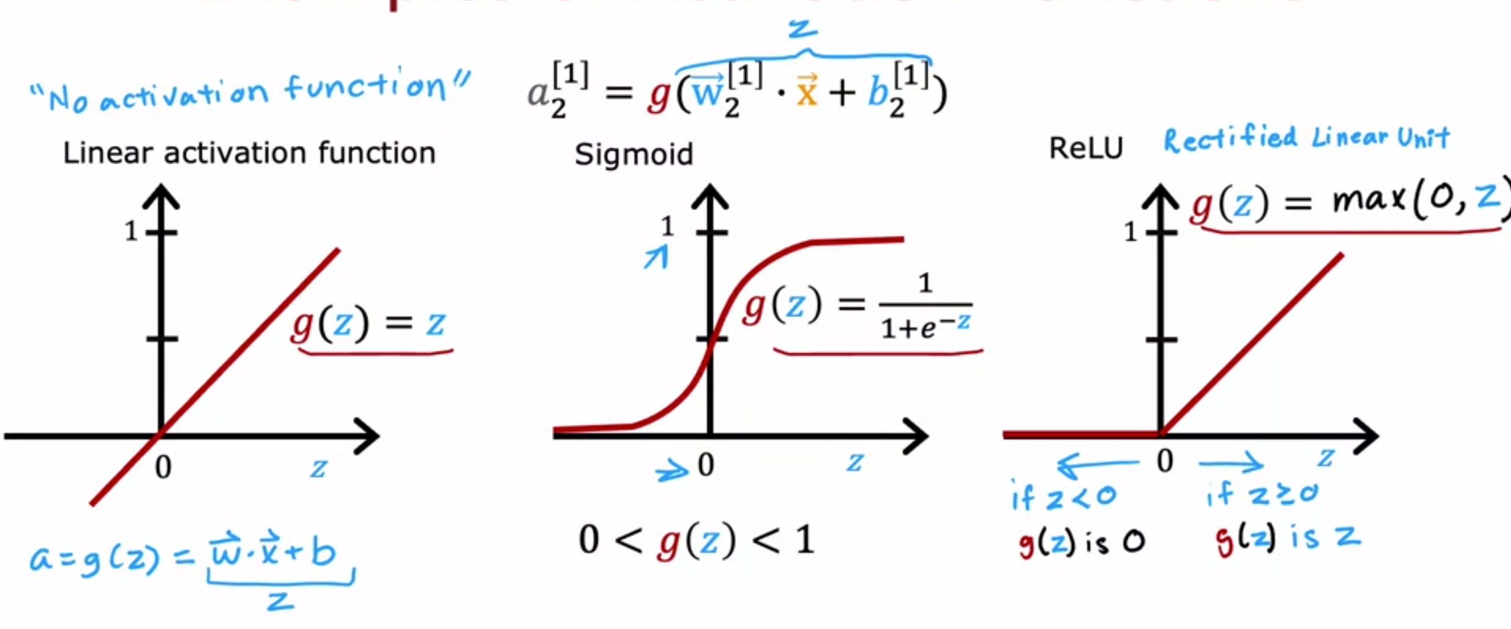
Example of Activation Function
07

Slide 36
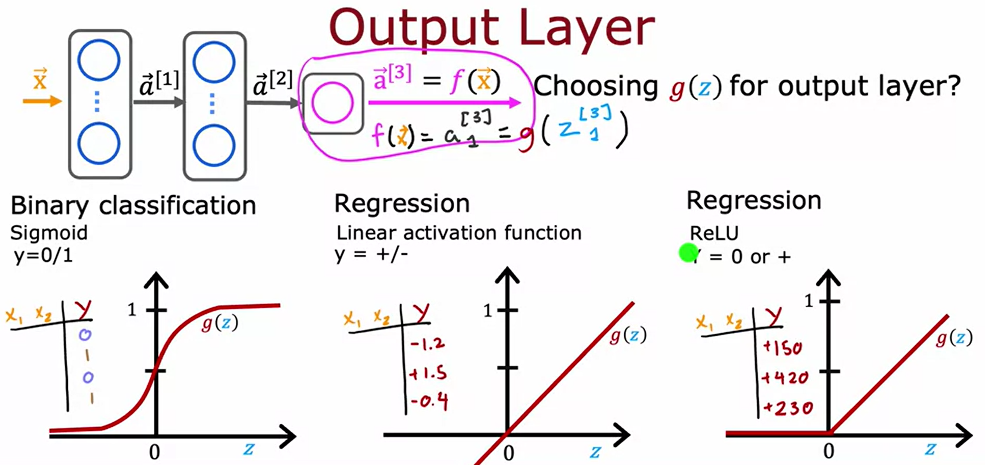
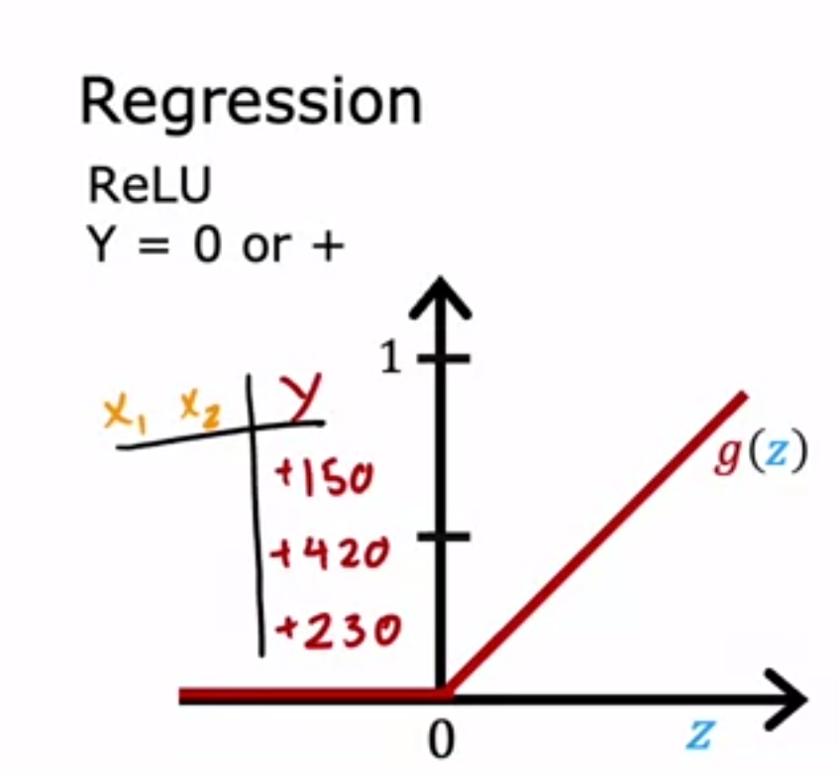
Choosing of Activation Function
07

Slide 37
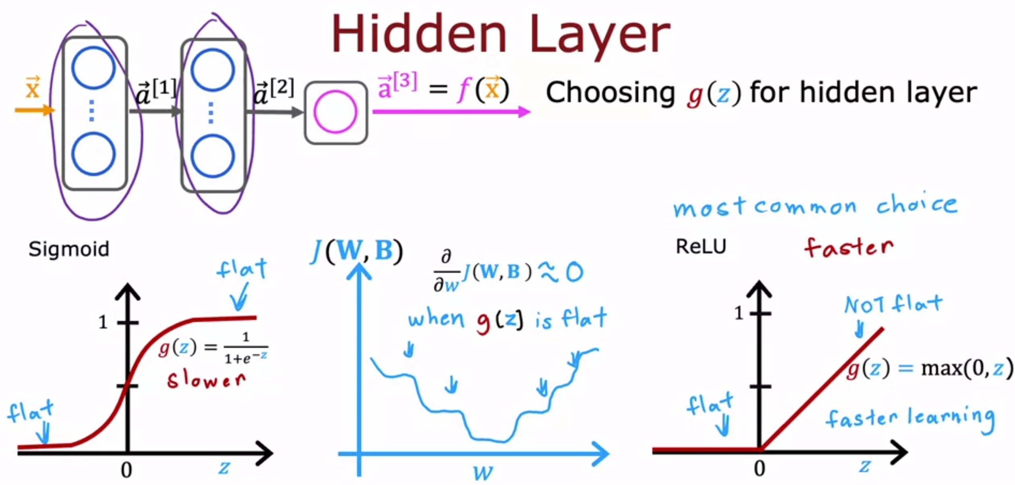
Choosing of Activation Function
07

Slide 38
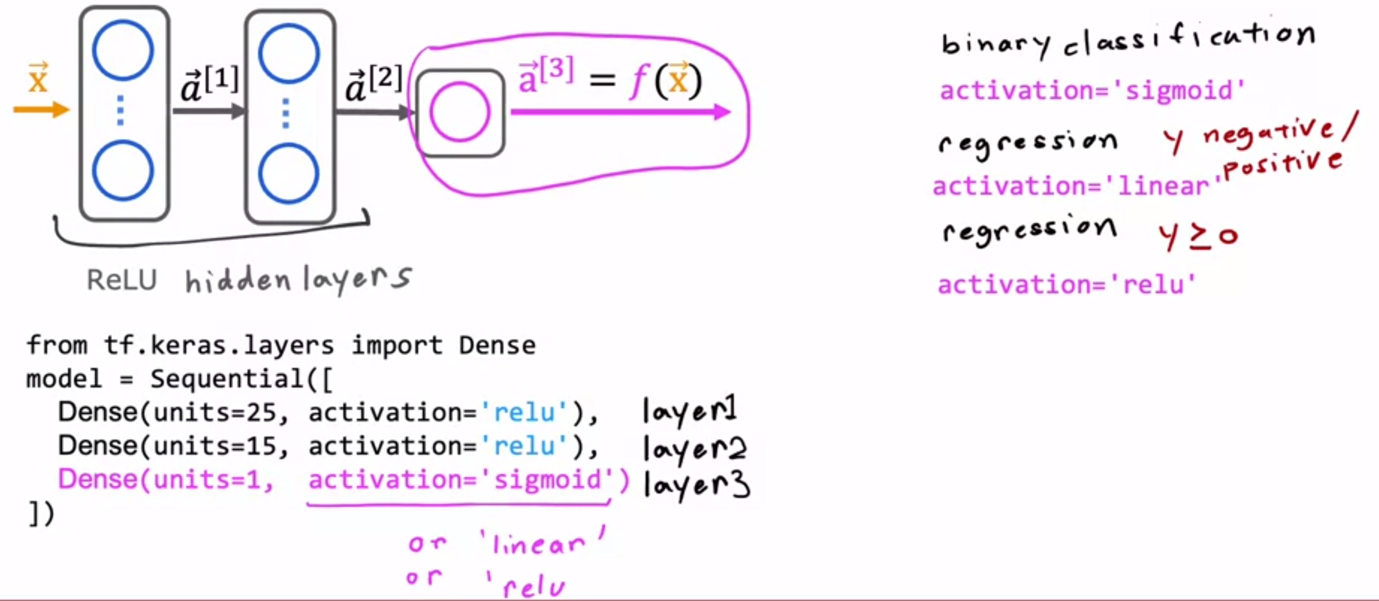
Choosing Activation Summary
07

Slide 39
08
Multiclass Classification

Slide 40
Multiclass Classification
04

Slide 41
09
Seminar Session

Slide 42
Thanks for Listening

